Slide 1

Overview On Cybercrimes

Slide 2
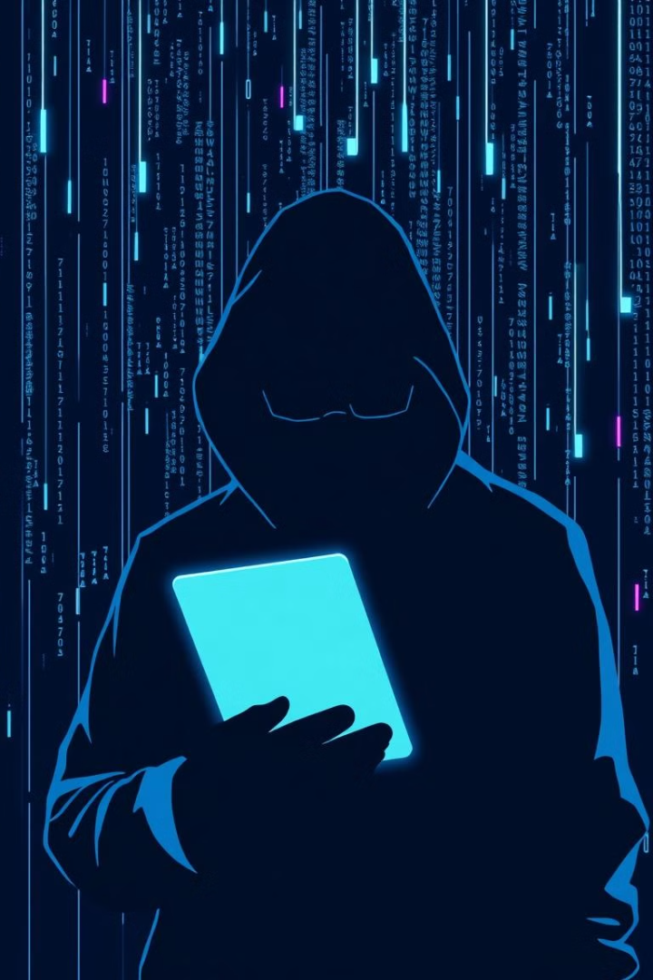
What is Cybercrime…?
Cyber crimes are illegal activities that are carried out using computers, digital devices, or the internet. These crimes target computer systems, networks, or data, or use them as tools to commit other offenses.

Slide 3





Motivations Behind Cybercrime
Financial Gain
Ideological
Personal
Espionage

Slide 4
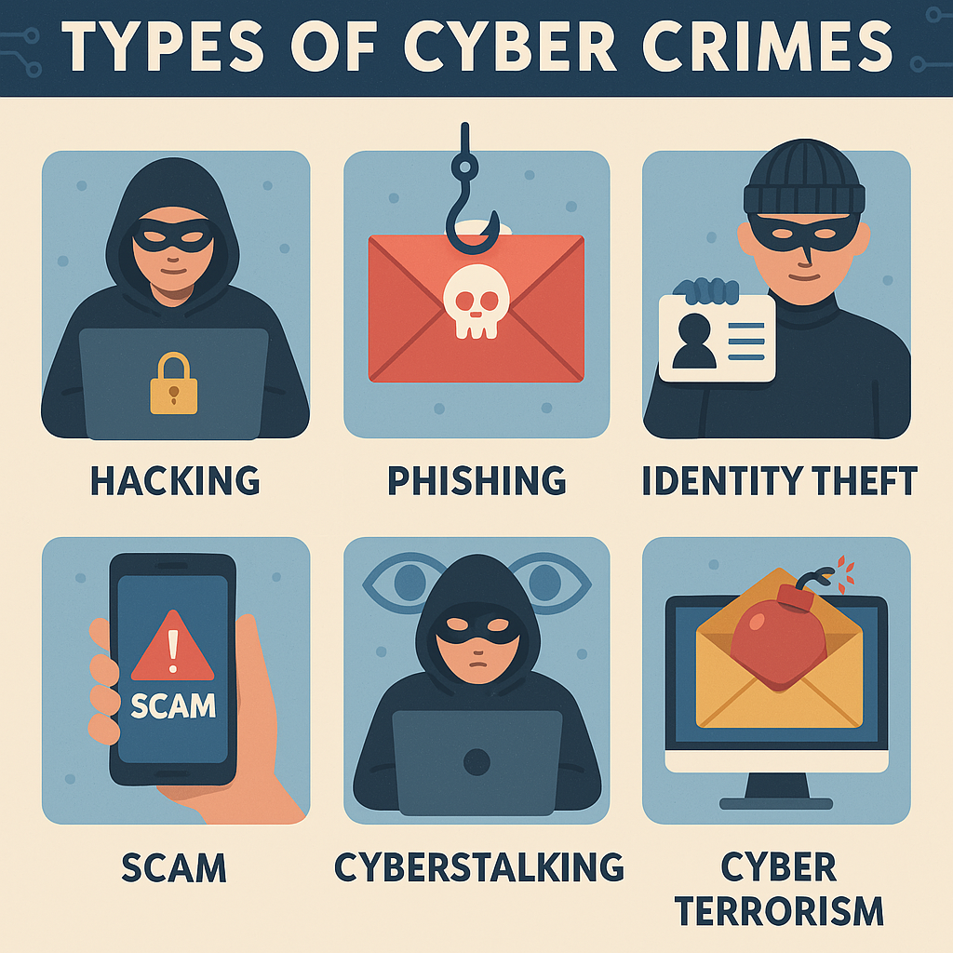
Types of Cybercrime

Slide 5
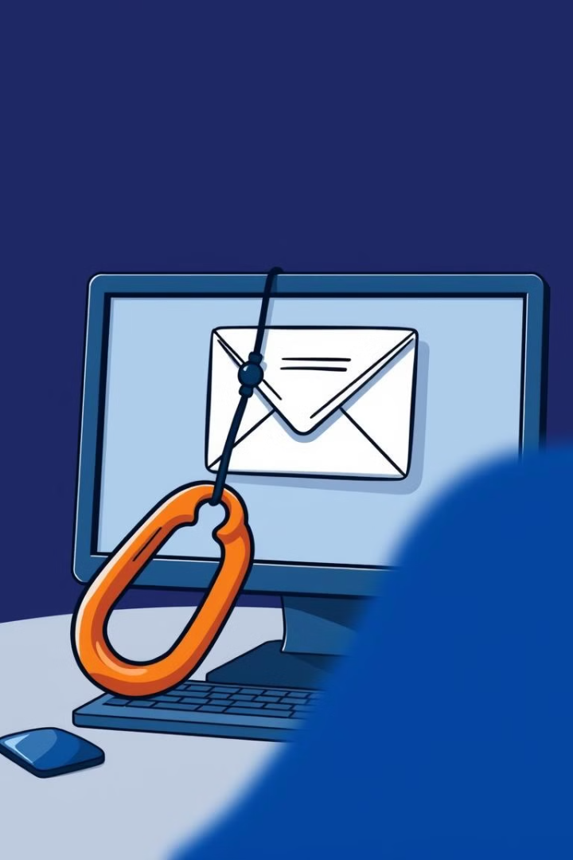
1. Phishing
A form of cybercrime wherein an individual or entity, through deceptive means, attempts to illicitly acquire sensitive information, including but not limited to passwords, financial data, or personal identifiers, by masquerading as a trustworthy or legitimate entity, often through electronic communication channels such as email, messaging platforms, or spoofed websites.
Example
The 2023 Twilio breach exposed customer data.

Slide 6
Phishing Techniques
Malicious Web Links: Phishing links that take users to websites infected with malware.
Malicious Attachments: Infected attachments that can compromise computers.
Fraudulent Data-Entry Forms: Fake forms that trick victims into revealing sensitive information.
Link Manipulation: Disguising malicious links as trusted links.
Content Injection: Injecting malicious content into official websites

Slide 7




2. Malware
Malicious Software
Malware includes viruses, worms, ransomware, and spyware.
Ransomware
Ransomware encrypts data. Payment is demanded for its release.
Global Impact
The 2017 WannaCry ransomware attack had a global impact.
Malware caused around $20 billion in global losses in 2021.

Slide 8

3. Hacking
Unauthorized access, modification, or manipulation of computer systems, networks, or data, often with malicious intent, compromising the security, integrity, or confidentiality of such systems or data
Website Hacking
Cyber Terrorism
Cyber Espionage

Slide 9
Types of hacking
In the context of ethical considerations, hacking can be categorized into different types based on the hacker's intent:​
Ethical Hacking: Also known as penetration testing, this involves legally breaking into computers and devices to test an organization's defenses. ​
Unethical Hacking: Involves malicious activities such as stealing data, causing disruption, or conducting unauthorized surveillance.​

Slide 10
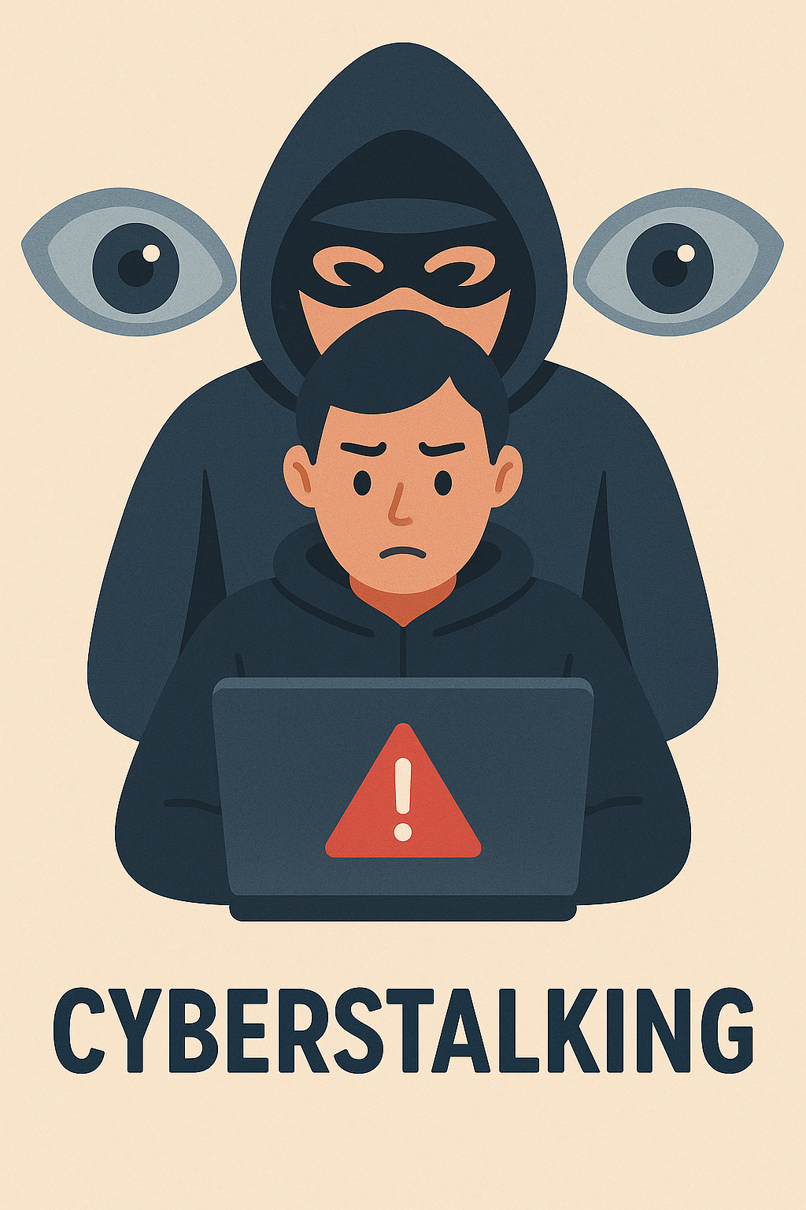
4. Cyber Stalking
Cyberstalking is the use of the internet or other digital technologies to harass, threaten, or intimidate someone repeatedly and persistently.
Involves unwanted and obsessive attention online.
May include sending threatening messages, spreading false information, or monitoring someone's online activities.
Often happens through email, social media, messaging apps, or other digital platforms.
Can cause serious emotional distress or fear in the victim.
Cyberstalking is considered a serious form of online harassment and is punishable under cybercrime laws in many countries.

Slide 11




Impact of Cybercrime
Financial Losses
1
Reputational Damage
Direct and recovery costs
2
Loss of customer trust
Operational Disruption
4
Data Breaches
3
Downtime, productivity loss
Exposure of sensitive info

Slide 12




Cybercrime Prevention & Reporting
Strong Passwords
1
Use unique passwords and MFA.
Software Updates
2
Regularly update software and antivirus.
Education
3
Educate about phishing and scams.
Report Incidents
4
Report incidents to law enforcement.

Slide 13




Future Trends in Cybercrime
AI Attacks
Sophisticated phishing, malware
IoT Vulnerabilities
Increased attack surface
Cryptocurrency
Facilitates illicit transactions
Focus on prevention, education, and international collaboration.

Slide 14
THANK YOU…

